Slide 1

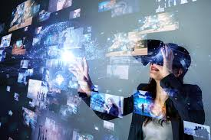
VIRTUAL REALITY(VR)
Indira College Of Commerce And Science(ICCS)Pune
Presented By-
Vaishnavi Kolhe
Pranjal Kolhe

Slide 2
Index
1.Introduction
2.Defination
3. What is Virtual Reality ?
4.History
5. Types of Virtual Reality
6.Application
7. Advantages and Disadvantages

Slide 3
1.INTRODUCTION
VR is a very high end computer interface that evolves real time simulation and interface through numerous sensorial channels. A key component in most virtual reality systems is the ability to perform a walkthrough of a virtual environment from different viewing positions and orientations. The walkthrough requires the synthesis of the virtual environment and the simulation of a virtual camera moving in the environment with up to six degrees of freedom.

Slide 4
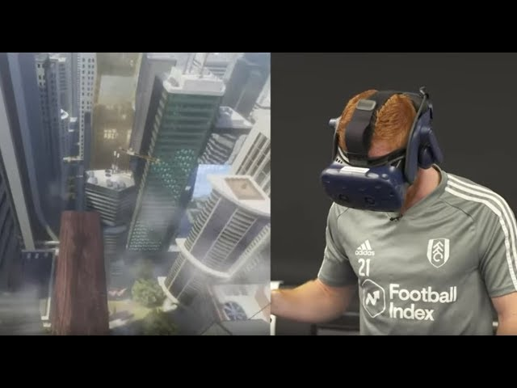
2.Defination
“A computer generated simulation that enables people to interact with visual and sensory three-dimensional objects or environments through the use of computer modeling”.

Slide 5
3.What is Virtual Reality ?
Virtual Reality means feeling the imaginary(virtual) world, rather than the real one. The imaginary world is a simulation running in a computer.
Virtual reality is the term used for computer generated 3D environments that allow the user to enter and interact with alternate realities.
The definition of 'virtual' is near and 'reality' is what we experience as human beings.

Slide 6
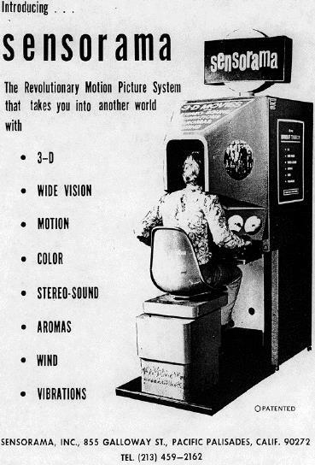
4. History
More than one person has been involved in the development of this technological system.
In 1950's visionary cinematography Morton Heilig built a single user console called Sensorama. This enabled the user watch television in 3 dimensional ways.

Slide 7
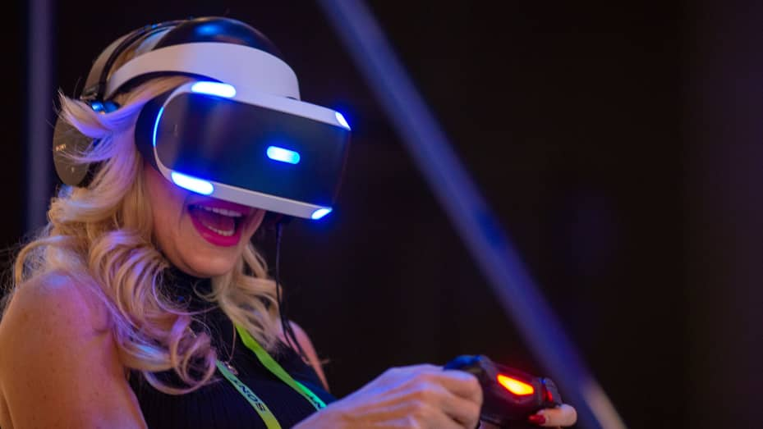
5.Types of Virtual Reality
Immersive Virtual Reality
Non-Immersive Virtual Reality
Window on world Virtual Reality

Slide 8
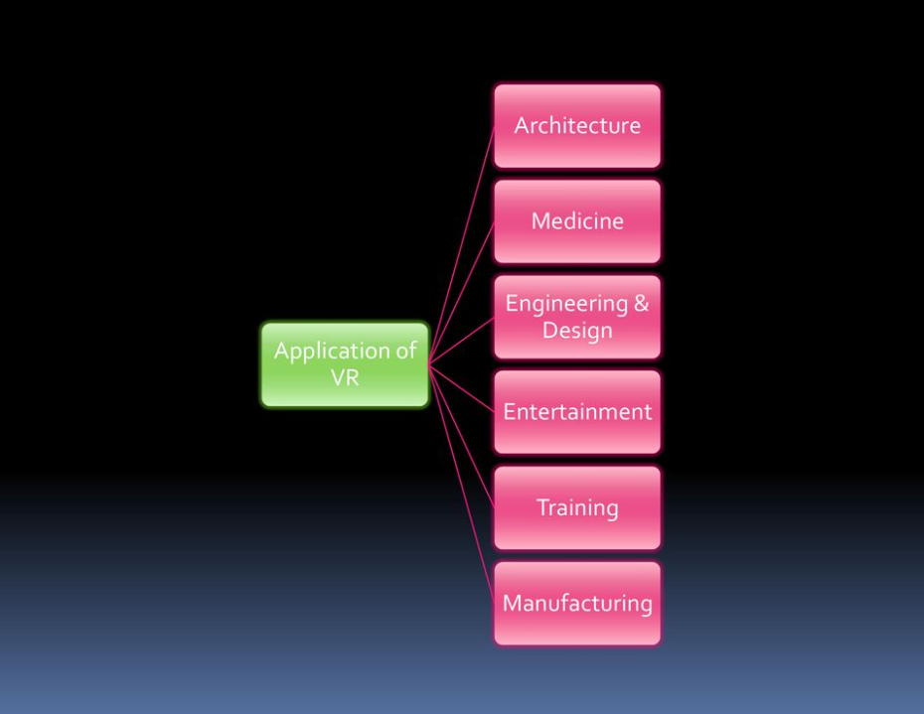
6.Applications

Slide 9
7.Advantages and Disadvantages
Advantages
Disadvantages
Virtual reality creates a realistic world
It enables user to explore places.
Through Virtual Reality user can experiment with an artificial environment.
Virtual Reality make the education more easily and comfort.
The equipments used in virtual reality
are very expensive.
It consists of complex technology.
In virtual reality environment we cant
move by our own like in the real world.

Slide 10

